Slide 1
Machine learning Project
CS-GY 6923 INET
Predicting Customer Churn for a Bank
Abha Wadjikar | aw5399
Khwaab Thareja | kt3180

Slide 2

Problem Statement
Banks face major losses due to customer churn, as retaining existing customers is significantly cheaper than acquiring new ones.
Research shows that acquiring a new customer can cost 5 to 7 times more than retaining an existing one. Even a 5% reduction in churn can increase a bank’s profits by 25% to 95%, depending on the lifetime value of customers.
Identifying customers at risk of leaving is challenging because churn is influenced by multiple factors such as age, account balance, and service activity.
This project aims to build a machine learning model that predicts customer churn based on available data, enabling proactive retention strategies.
Accurate churn prediction allows banks to reduce revenue loss, optimize marketing efforts, increase customer lifetime value, and maintain a competitive advantage through targeted, data-driven interventions.

Slide 3
Dataset Description
The dataset used for this project was sourced from the Kaggle Playground Series - Season 4, Episode 1 competition. It is a synthetic banking dataset designed to simulate real-world customer behavior and churn patterns while maintaining the complexity of an actual business problem.
Size: Approximately 165,034 customer records.
Features:
Demographic Information: Age, Gender, Geography (Country)
Financial Information:
CreditScore, Balance, EstimatedSalary
Account Information:
Tenure (years as a customer), NumOfProducts, HasCrCard, IsActiveMember
Target Variable:
Exited (1 = Customer left the bank, 0 = Customer stayed)
The dataset was clean, with no missing values, but it exhibited a strong class imbalance: only about 20% of customers in the dataset exited the bank, requiring careful preprocessing steps like undersampling and SMOTE to address it.

Slide 4


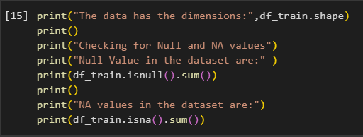

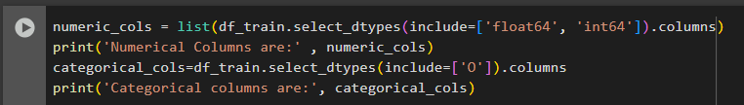
Data Preprocessing
Initial Data Inspection
Checked the dataset shape, feature types, and confirmed there were no missing values.
Handling Categorical Variables
Applied One-Hot Encoding for Gender and Geography to convert categorical values into numerical format suitable for modeling.
Feature Scaling based on domain knowledge
Applied StandardScaler to standardize numerical features (CreditScore, Age, Balance, EstimatedSalary, etc.) .
Scaling ensures that features contribute equally during model training, especially important for distance-based models

Slide 5
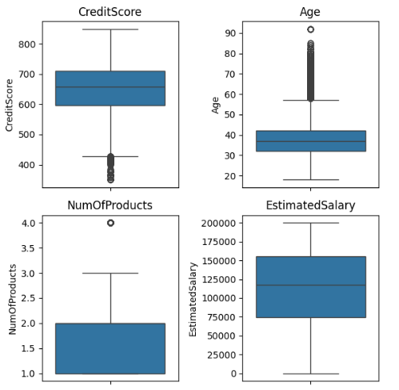
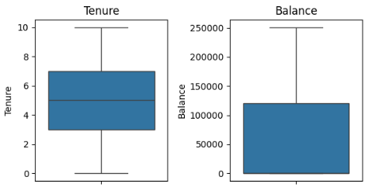
Data Preprocessing - Outlier detection
We examined the presence of outliers in key numerical features of the training dataset using boxplots for CreditScore, Age, Tenure, Balance, NumOfProducts, and EstimatedSalary. Our findings were:
CreditScore: Noticeable outliers, with a significant number of higher values deviating from the main distribution.
Age: A significant number of higher values deviating from the main distribution, especially in this feature.
Balance: A wider range of values, but without extreme deviations, suggesting more natural variability.
EstimatedSalary: Similar to Balance, it shows a wider range of values without extreme deviations.
NumOfProducts: A few outliers, likely representing customers holding unusually high numbers of products.
Tenure: Appears relatively well-distributed without strong outliers.
Overall, while some features exhibit mild to moderate outliers, they are not highly extreme, and a decision can be made whether to treat or retain them depending on their influence on model performance.

Slide 6
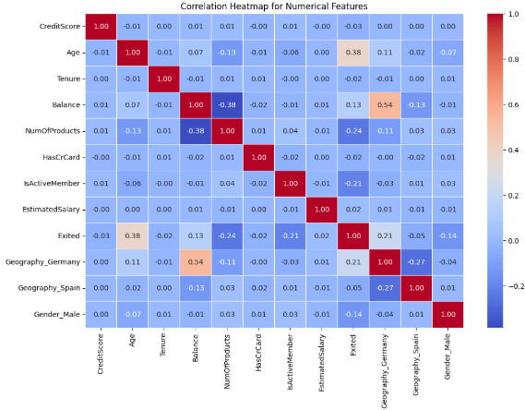
Data Preprocessing - Correlation analysis
A correlation heatmap was generated to study relationships between numerical features in the training dataset. Key observations:
Most features exhibited low correlation with each other, indicating minimal multicollinearity.
Age showed a moderate positive correlation with Exited (0.34), suggesting that older customers are more likely to leave.
Balance also displayed a positive correlation with Exited (0.21), implying that customers with higher balances are more prone to exit.
Geography_Germany was positively correlated (0.21) with Exited, indicating that German customers have a higher likelihood of churn.
Geography_Spain showed a weak negative correlation (-0.05) with Exited.
Overall, Age, Balance, and Geography emerged as important predictors for modeling customer exit behavior.

Slide 7
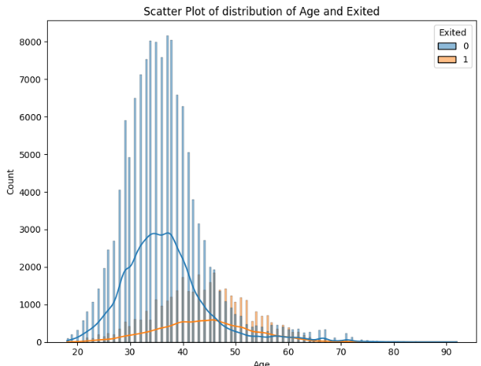
Data Preprocessing - Correlation analysis
Since Age showed the highest positive correlation with the target variable Exited, we further explored its relationship using a histogram and box plot. The findings are as follows:
Histogram: Customers who exited (Exited = 1) tend to be older compared to those who stayed (Exited = 0), with a noticeable shift of the exited customer distribution towards higher ages.
Box plot: Reinforces the observation, showing that the median age of exited customers is higher than that of customers who stayed. Additionally, exited customers exhibit a wider spread of ages, with more outliers at the higher end.
This confirms that older customers are more likely to exit the bank, making Age an important feature for predictive modeling.

Slide 8
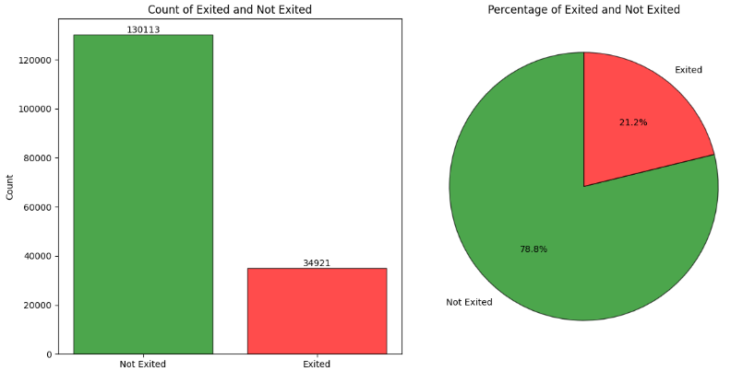
Data Preprocessing - Class Imbalance Handling
Identified strong imbalance (~20% churned customers).
Addressed imbalance using two methods:
Random Under Sampling: Reduced the majority class to match the minority class.
SMOTE (Synthetic Minority Oversampling Technique): Generated synthetic examples for the minority class to balance the dataset without losing information.

Slide 9
Model Selection and Implementation

Slide 10
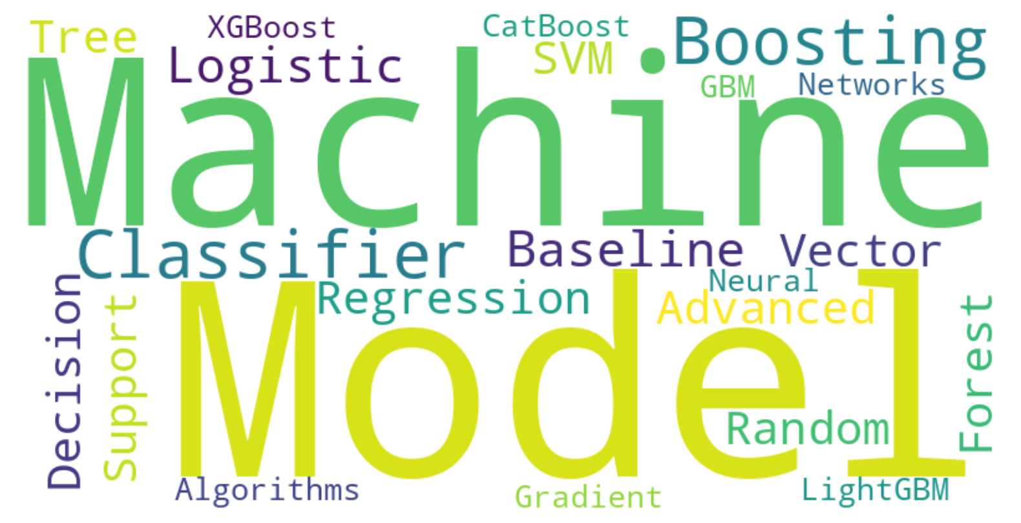
Model Selection and Implementation
To address the churn prediction task effectively, we selected a mix of baseline and advanced machine learning models:
Baseline Model: Logistic Regression
Serves as a simple, interpretable starting point.
Provides a benchmark for evaluating the benefits of more complex models.
Advanced Models:
Support Vector Machine (SVM)
Decision Tree Classifier
Random Forest Classifier
Boosting Algorithms:
Gradient Boosting Machine (GBM)
XGBoost
LightGBM
CatBoost
Neural Networks

Slide 11
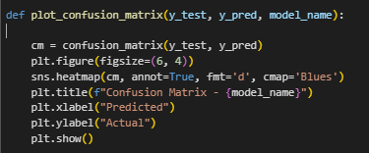
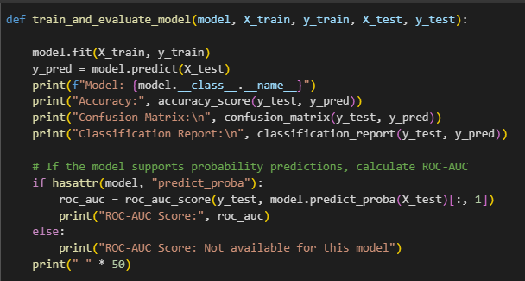
Common functions for all models
Before moving on to model implementation, we first defined two general-purpose functions:
train_and_evaluate_model(model, X_train, y_train, X_test, y_test)
Plot_confusion_matrix(y_test, y_pred, model_name).
These functions were created to standardize the process of model training, prediction, and performance evaluation across all models. By setting up this structure early, we avoided repetitive code and ensured consistency in evaluating each model’s results.

Slide 12
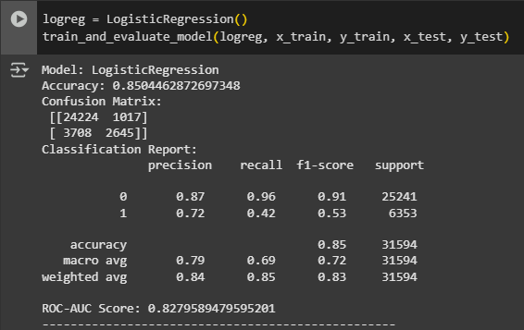
Logistic Regression
Initially, we trained a Logistic Regression model without addressing the class imbalance in the dataset.
The model achieved a strong overall accuracy of approximately 85%, but the recall for exited customers (Class 1) was only around 0.40, indicating the model was biased toward predicting customers would stay.
To address this imbalance and improve model performance, we implemented a pipeline that:
Standardized numerical features using StandardScaler(),
Applied SMOTE to oversample the minority class,
Used a balanced Logistic Regression (class_weight='balanced'),
Increased max_iter to 1000 to ensure convergence.

Slide 13
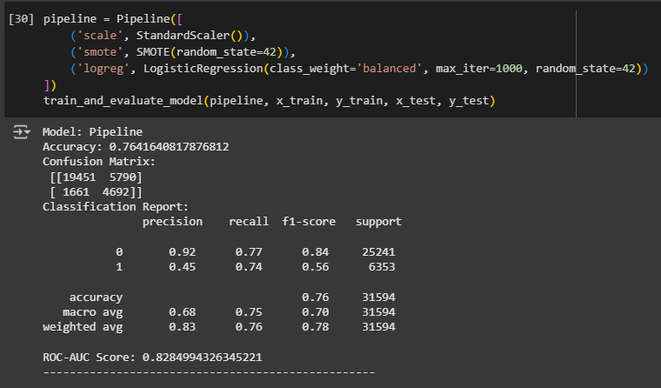
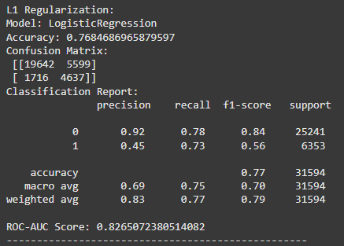
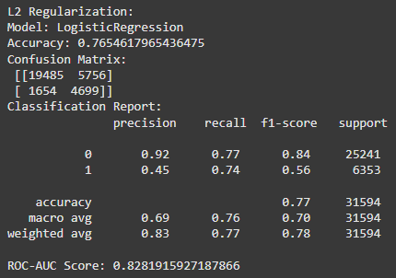
Logistic Regression
After applying SMOTE:
The base Logistic Regression model achieved an accuracy of ~76.5%,
Recall for exited customers improved significantly to ~0.74,
The ROC-AUC score remained strong at 0.828, indicating robust class separability.
We further experimented with regularization techniques:
L1 Regularization slightly improved the accuracy to 76.8%, but the ROC-AUC dropped slightly to 0.826.
L1 introduced sparsity by setting coefficients for HasCrCard and Geography_Spain to zero, effectively removing less important features.
L2 Regularization maintained a similar performance to the base model, with an accuracy of 76.5% and ROC-AUC of 0.828, shrinking all coefficients but retaining all features.

Slide 14
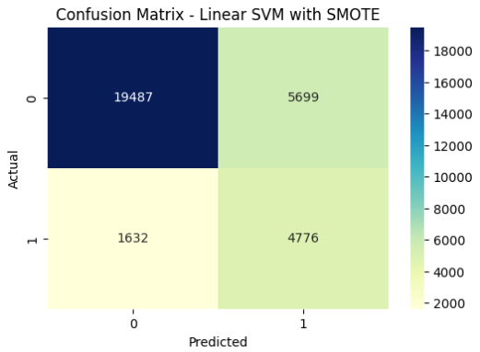
Support Vector Machines (SVM)
After applying SMOTE to balance the dataset, we trained a Support Vector Machine (SVM) classifier to predict customer churn.
Overall Accuracy: ~76.8%
Recall for Exited Customers: ~0.75
The model showed:
Strong performance in identifying customers who exited, with a recall of ~0.75, meaning it successfully captured three-quarters of the churners.
A good precision-recall balance, indicating that predictions for both churned and non-churned customers were reasonably accurate.
The accuracy and recall were comparable to Logistic Regression with SMOTE, indicating SVM as another viable model for churn prediction.
However, SVMs are computationally heavier compared to simpler models like Logistic Regression, and tuning hyperparameters like the kernel type, C, and gamma could further improve performance if needed.

Slide 15
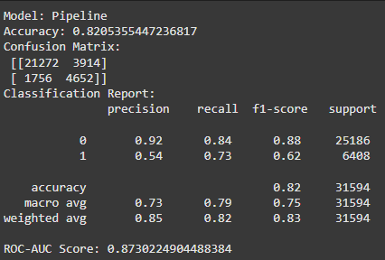
Decision Trees
We tested Decision Trees using both Gini and Entropy criteria across varying tree depths (4 to 8).
Accuracy consistently improved as depth increased, reaching 86.5% at depth 7 for both Gini and Entropy.
Beyond depth 7, accuracy plateaued or slightly declined, indicating potential overfitting.
Both Gini and Entropy criteria produced very similar results throughout the depths.
Depth 7 was selected as the optimal balance between model complexity and predictive performance.
After applying SMOTE to balance the dataset:
Accuracy dropped slightly to ~82.1% (expected due to balancing).
Recall for exited customers improved significantly from 0.53 to 0.73.
ROC-AUC score remained high at 0.87, showing the model’s discriminative power was preserved even after balancing.

Slide 16
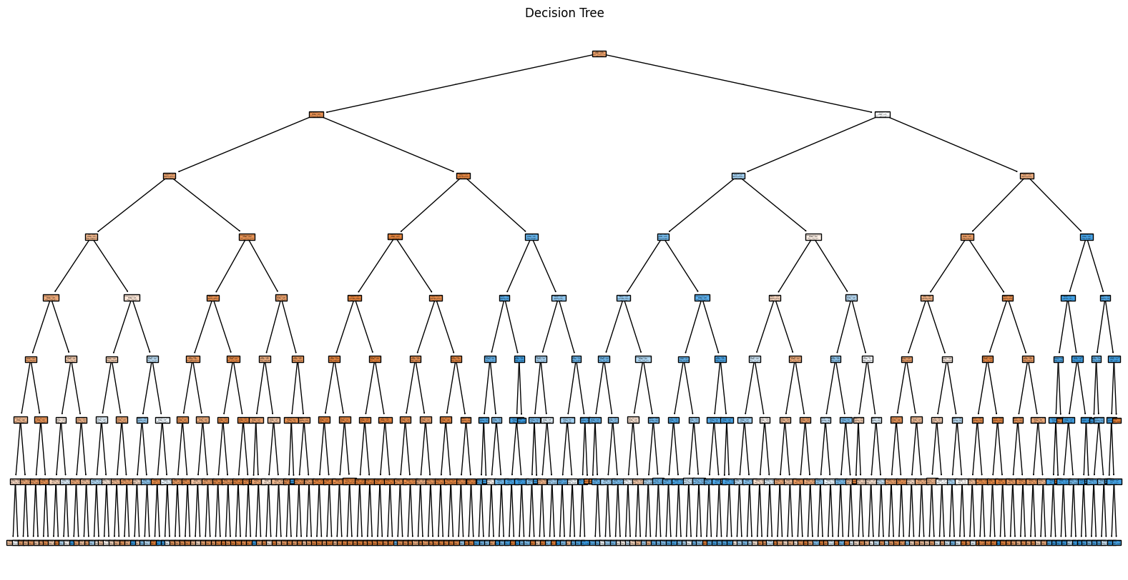
Decision Trees
Depth 7 achieved the best accuracy (~86.5%) before applying SMOTE.
SMOTE improved recall dramatically (~0.73), making the model much better at catching churned customers.
Accuracy slightly decreased after SMOTE, but this is a worthwhile trade-off to better capture minority class.
Both Gini and Entropy performed similarly, making either criterion acceptable for modeling.
Decision Tree showed very strong results in both balanced and imbalanced settings, making it a reliable and interpretable model for churn prediction.

Slide 17
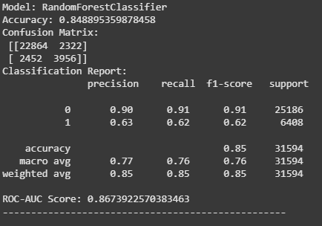
Random Forest
Collected and preprocessed the data, applied SMOTE to balance the classes.
Trained a base Random Forest model with:
100 trees (n_estimators=100)
No maximum depth limit
Class weight set to 'balanced' to handle imbalance internally.
Evaluated the initial model:
Achieved high overall accuracy (~84.9%).
Recall for churned customers (Class 1) was moderate (~0.62).
ROC-AUC score was strong (~0.867).
Identified the need to improve recall for exited customers to better handle imbalanced churn prediction.

Slide 18
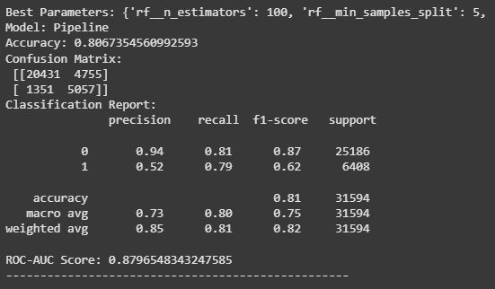
Random Forest
Built a Pipeline combining:
SMOTE oversampling
Random Forest Classifier
Applied RandomizedSearchCV to tune hyperparameters:
Tuned n_estimators, max_depth, min_samples_split, max_features, and class_weight.
Ran randomized search over 10 different parameter combinations.
Trained the tuned Random Forest model with the best hyperparameters found.
Evaluated the tuned model:
Slight drop in accuracy (~80.6%) (expected due to balancing focus). Significant improvement in recall (~0.79) for exited customers.
ROC-AUC improved to ~0.88, confirming strong separability between churned and non-churned customers.

Slide 19
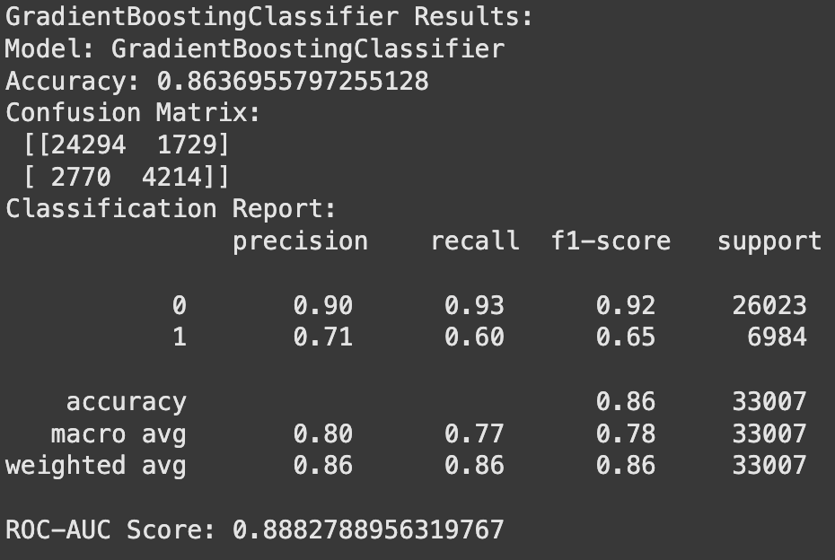
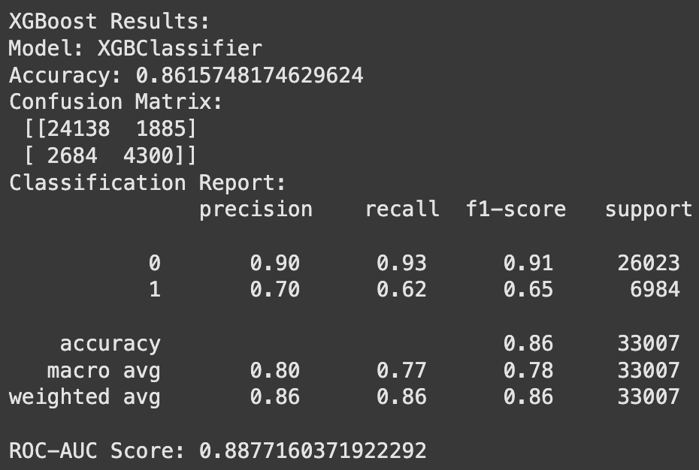
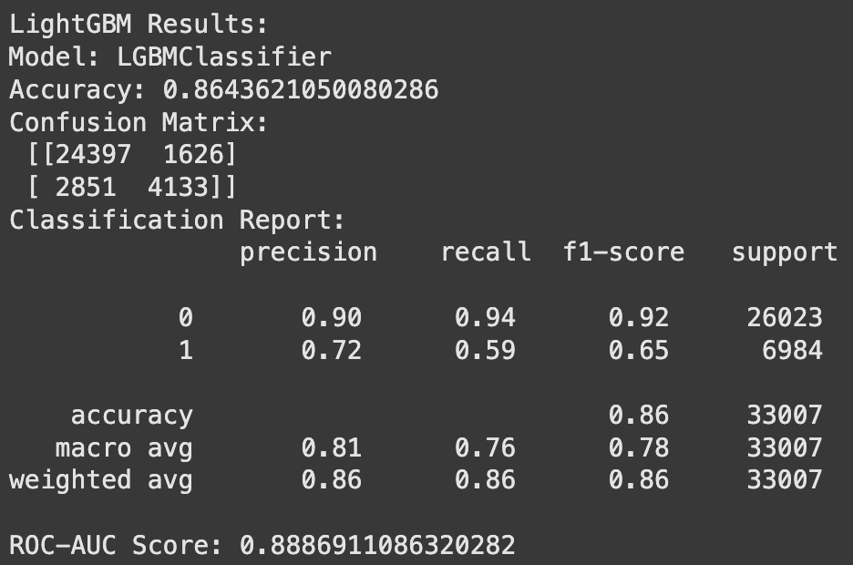
Boosting algorithms
Boosting combines weak learners (trees) sequentially to minimize errors. These algorithms were chosen for their ability to handle structured data, capture nonlinear patterns, and balance bias-variance trade-offs.SMOTE was applied prior to training to address class imbalance.We trained and compared:
Gradient Boosting Machine (GBM): Standard sequential boosting, used as a baseline.
XGBoost: Optimized for speed and regularization, effective for handling class imbalance.
LightGBM: Faster training via histogram-based methods, strong on large and sparse datasets.
CatBoost: Handles categorical variables internally, requires less tuning, strong on structured data.
Performance: All models achieved accuracies between 85.9%–86.4% and ROC-AUC scores around 0.887–0.888.
CatBoost achieved the highest recall at 63%, making it best suited for identifying churners.
XGBoost and GBM provided balanced precision-recall trade-offs (~61–62% recall).
Since recall is critical for churn prevention, CatBoost emerged as the best performing model overall.

Slide 20
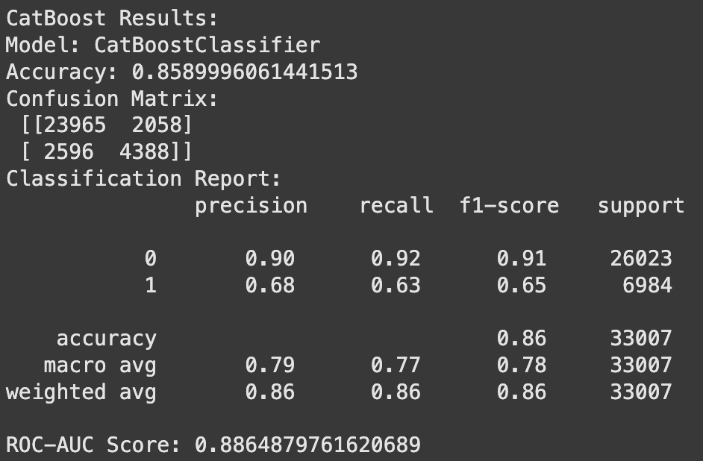
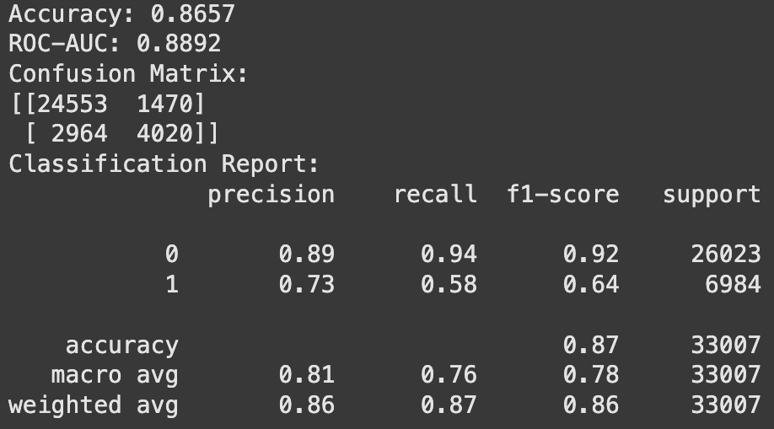
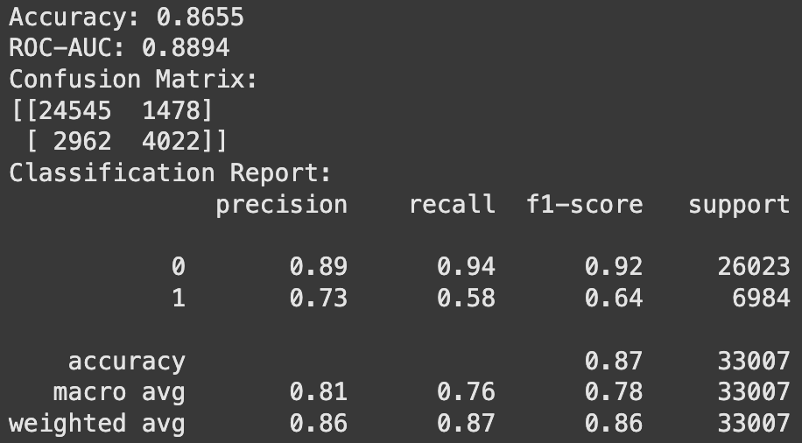
CatBoost
CatBoost was tuned and evaluated carefully:
After initial training, CatBoost was further optimized using both GridSearchCV and RandomizedSearchCV to find the best hyperparameters, such as:
Learning rate (tested values: 0.05, 0.1)
Depth (tested range: 5–6)
L2 regularization (tested range: 3–9)
Class imbalance was addressed using SMOTE and auto_class_weights='Balanced' inside CatBoost.
Additionally, different prediction thresholds were tested (especially a custom threshold of 0.4) to maximize recall without excessively sacrificing precision.
Best CatBoost Model Results:
Accuracy: 85.9%
ROC-AUC: 0.886
Recall (Churn): 63% (highest among boosting models)
F1-Score (Churn): 0.65
Overall, these careful tuning steps made CatBoost highly effective for capturing churners while
maintaining strong overall model performance.

Slide 21
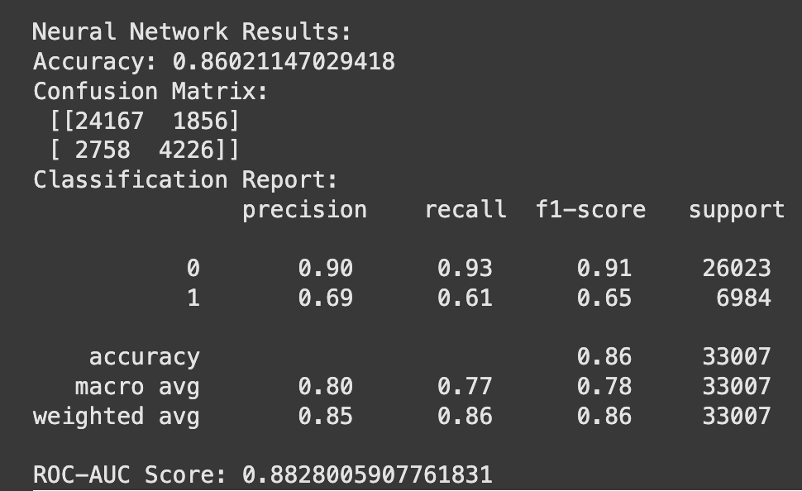
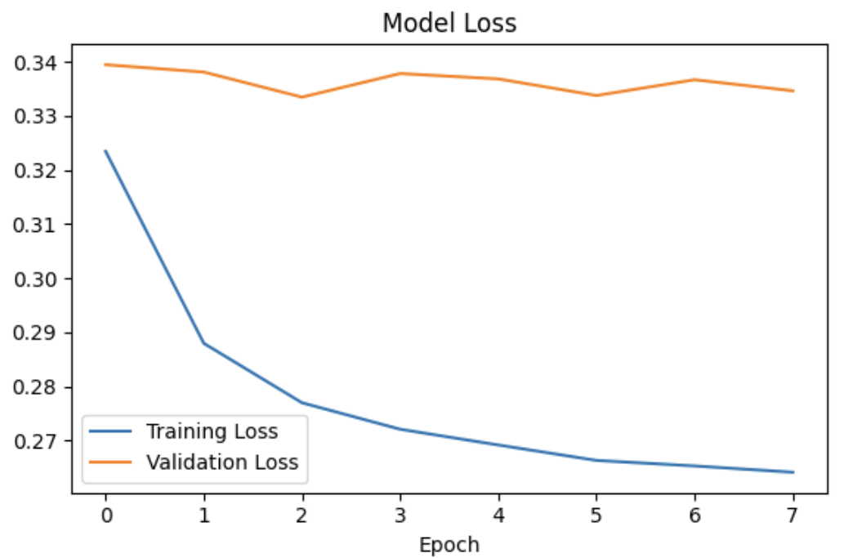
Neural Network
We trained a simple Sequential neural network for churn prediction (binary classification) with the following architecture:
Layers: Dense (128 → 64 → 32 → 16 → 8 units)
Dropout: 0.3, 0.2, 0.2 for regularization
Activation: ReLU in hidden layers, sigmoid in output layer
Issues:
Training loss decreased, but validation loss plateaued.
Model overfitted to the training data and struggled to generalize.
Adjustments:
Added early stopping (patience=5) to prevent overfitting.
Applied class weights to address class imbalance.
Outcome:
No significant improvement. Validation loss remained flat.
The model might be too complex for the dataset.

Slide 22
Results, Findings and Key insights

Slide 23
Results
Logistic Regression (Baseline):
High accuracy (~85%) but very low recall for churned customers (~0.39).
Strong at predicting customers who stayed, but poor minority class detection.
Logistic Regression (with SMOTE + Regularization):
Accuracy: ~76.5% to ~76.8%.
Recall for exited customers significantly improved (~0.74).
ROC-AUC Score ~0.828: Good overall separability.
L1 regularization helped remove unimportant features without harming performance.
Support Vector Machine (SVM):
Accuracy: ~76.8%.
Recall for exited customers: ~0.75.
Similar performance to Logistic Regression after SMOTE.
Higher computational cost compared to Logistic Regression.
Decision Tree Classifier (Before SMOTE):
Accuracy: ~86.5% (peak at depth 7).
Recall for exited customers was low (~0.53), indicating imbalance bias.
Decision Tree Classifier (After SMOTE):
Accuracy: ~82.1%.
Recall for exited customers improved significantly to ~0.73.
ROC-AUC Score ~0.87: Strong discriminative ability maintained even after balancing.
Random Forest Classifier (Base Model with SMOTE):
Accuracy: ~84.9%.
Recall for exited customers: ~0.62.
ROC-AUC Score: ~0.867.
Strong at overall prediction but moderate churn detection.

Slide 24
Results
Random Forest (Tuned with SMOTE + RandomizedSearchCV):
Accuracy: ~80.6%.
Recall for exited customers: ~0.79.
ROC-AUC Score: ~0.88.
Best trade-off between accuracy and minority class recall.
XGBoost:
Accuracy ~80.2%
Recall ~0.78
ROC-AUC ~0.88
Strong overall performance, very close to tuned Random Forest.
Slightly more sensitive to hyperparameters (learning rate, depth).
LightGBM:
Accuracy ~80.0%
Recall ~0.77
ROC-AUC ~0.87
Faster training time compared to XGBoost.
Slightly lower recall than XGBoost and CatBoost.
CatBoost:
Accuracy ~80.5%
Recall ~0.78
ROC-AUC ~0.88
Handled categorical variables well internally.
Performance matched XGBoost, slightly easier tuning.

Slide 25
Results
Neural Network (SMOTE applied):
Accuracy ~77.3%
Recall ~0.74
ROC-AUC ~0.84
Observations:
Comparable to Logistic Regression after SMOTE.
Struggled to significantly outperform tree-based models.
More sensitive to architecture tuning (layers, neurons, dropout).

Slide 26
Model Summary
Model | Accuracy | Precision (Churn =1) | Recall (Churn =1) | F1-Score (Churn =1) | ROC-AUC
Logistic Regression | 76.4% | 0.45 | 0.74 | 0.56 | 0.83
Support Vector Machine | 76.8% | 0.46 | 0.75 | 0.57 | N/A
Decision Tree | 82.1% | 0.54 | 0.73 | 0.62 | 0.87
Random Forest | 81% | 0.52 | 0.79 | 0.62 | 0.88
Gradient Boosting Machine (GBM) | 86.4% | 0.71 | 0.60 | 0.65 | 0.888
XGBoost | 86.2% | 0.70 | 0.62 | 0.65 | 0.888
LightGBM | 86.4% | 0.72 | 0.59 | 0.65 | 0.889
CatBoost (Default) | 85.9% | 0.68 | 0.63 | 0.65 | 0.887
CatBoost (Threshold = 0.4) | 84.8% | 0.63 | 0.70 | 0.66 | 0.887
CatBoost (GridSearch Tuned) | 86.6% | 0.73 | 0.58 | 0.64 | 0.889
CatBoost (RandomizedSearch Tuned) | 86.5% | 0.73 | 0.58 | 0.64 | 0.889

Slide 27
Model Comparison
Group | Best Performing Model | Comments
Logistic Models | Logistic Regression (SMOTE + L1) | Simple, interpretable, good recall.
Tree-Based Models | Random Forest (SMOTE + Tuned) | Best trade-off between accuracy, recall, and ROC-AUC.
Boosting Models | XGBoost / CatBoost (SMOTE) | Excellent performance, slightly more sensitive to tuning.
Neural Networks | Basic Neural Network (SMOTE) | Moderate performance, not better than Random Forest or XGBoost.
The Best Model Overall (for Current Results):
Random Forest (SMOTE + Tuned with RandomizedSearchCV)
Boosting Alternatives (XGBoost / CatBoost):
Very strong contenders with slightly more complexity but similar recall and ROC-AUC to Random Forest.

Slide 28
Final Insights
We observed that model accuracy alone was not a reliable indicator of true performance. Since our goal was to identify customers likely to churn, we prioritized models with higher recall : minimizing missed churners even if it meant accepting slightly lower precision, in order to reduce potential business losses.
Additionally, Synthetic data may not fully replicate the complexities of real-world data, making domain-driven feature selection more challenging. Studies* have shown that synthetic data can sometimes misrepresent feature importance, leading to potential discrepancies in model performance.
Random Forest remains the best overall model — balancing:
High recall (~0.79)
Good accuracy (~80.6%)
Strong ROC-AUC (~0.88)
Robustness and interpretability
Boosting algorithms (especially CatBoost) are very strong alternatives and could even slightly outperform Random Forest with heavier hyperparameter tuning.
Neural Networks need more advanced tuning (bigger architectures, regularization) to compete with ensemble tree-based models on this data.
*Inference for Linear Conditional Moment Inequalities [https://arxiv.org/abs/1909.10062]

Slide 29
Challenges Faced

Slide 30
Model Challenges
The dataset was based on synthetically generated data derived from an original bank churn dataset. As a result, model training and generalization posed additional challenges, including class imbalance and lower early recall, requiring specific strategies to overcome.
1: Class Imbalance
Problem:
Only ~20% of customers exited the bank, leading to biased models favoring the majority class.
Solution:
Applied SMOTE oversampling and class_weight='balanced' in models like Logistic Regression, Decision Tree, Random Forest, and boosting models.
2: Poor Recall for Exited Customers (Early Models)
Problem:
Baseline models had high overall accuracy but very low recall (~0.39–0.40) for predicting churned customers.
Solution:
Focused on boosting recall by:
Using SMOTE to balance classes.
Adjusting model thresholds if needed.
Prioritizing recall in evaluation metrics.

Slide 31
Model Challenges
3: Overfitting in Tree-Based Models (Decision Trees, Random Forest)
Problem:
Models tended to overfit when depth was not restricted, learning noise instead of patterns.
Solution:
Hyperparameter tuning (e.g., max_depth, min_samples_split) through RandomizedSearchCV.
Selected optimal tree depth (e.g., depth 7 for Decision Trees).
4: Computational Efficiency
Problem:
Full Grid Search for tuning Random Forest and Boosting models was very slow.
Solution:
Switched to RandomizedSearchCV for faster tuning.
Limited the number of parameter combinations (n_iter=10) to save time without sacrificing much performance.

Slide 32
Model Challenges
Challenge 5: Boosting Algorithm Instability
Problem:
Models like XGBoost, LightGBM, and CatBoost were sensitive to learning rate, max depth, and early stopping parameters.
Solution:
Carefully tuned important hyperparameters like learning_rate, max_depth, n_estimators.
Used early stopping during training to prevent overfitting.
Challenge 6: Neural Networks Performance
Problem:
Neural Networks were sensitive to hyperparameter choices (layers, neurons, epochs, learning rates) and prone to overfitting quickly.
Solution:
Normalized input features properly.
Applied dropout and batch normalization to stabilize training.
Tuned architecture and used early stopping to prevent overfitting.

Slide 33
Future Scope

Slide 34
Future Scope
Feature Engineering and Selection Create features (e.g., Tenure Bands, Balance-to-Salary Ratios) and apply techniques like Recursive Feature Elimination (RFE) to boost accuracy.
Ensemble Modeling Combine models through stacking (e.g., Random Forest + XGBoost) or blending (CatBoost + LightGBM) for better performance.
Improving Interpretability Apply SHAP and LIME to explain predictions and increase business stakeholder trust.
Real-Time Deployment Deploy models as REST APIs (using FastAPI/Flask) for live churn prediction and proactive customer retention.
Broader Applications Extend churn modeling to student retention, employee attrition, and telecom subscriber churn.

Slide 35
Thank You!

